Slide 1
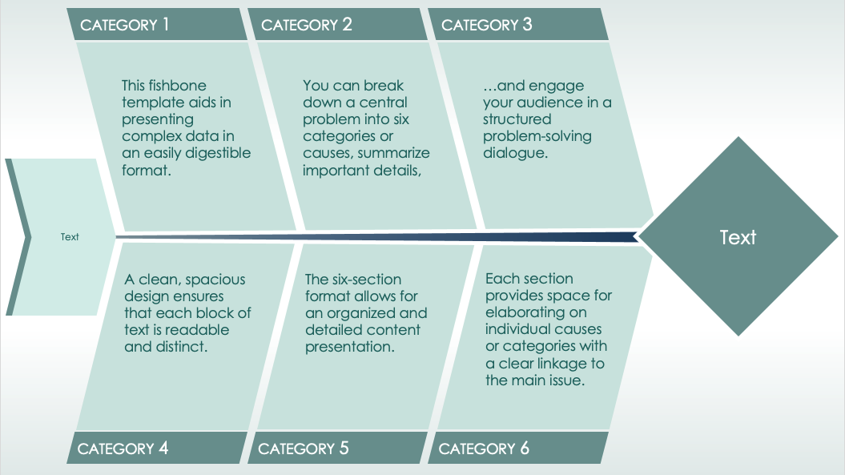
6-Prong Fishbone Diagram Template
When to Use This Template: This fishbone template aids in presenting complex data in an easily digestible format. You can break down a central problem into six categories or causes, summarize important details, and engage your audience in a structured problem-solving dialogue.
Notable Template Features: A clean, spacious design ensures that each block of text is readable and distinct. The six-section format allows for an organized and detailed content presentation. Each section provides space for elaborating on individual causes or categories with a clear linkage to the main issue.

Slide 2
CATEGORY 1
CATEGORY 2
CATEGORY 3
This fishbone template aids in presenting complex data in an easily digestible format.
You can break down a central problem into six categories or causes, summarize important details,
…and engage your audience in a structured problem-solving dialogue.
Text
Text
A clean, spacious design ensures that each block of text is readable and distinct.
The six-section format allows for an organized and detailed content presentation.
Each section provides space for elaborating on individual causes or categories with a clear linkage to the main issue.
CATEGORY 4
CATEGORY 5
CATEGORY 6

Slide 3
CATEGORY 1
CATEGORY 2
CATEGORY 3
Text
Text
Text
Text
Text
Text
Text
Text
CATEGORY 4
CATEGORY 5
CATEGORY 6

Slide 4
DISCLAIMER Any articles, templates, or information provided by Smartsheet on the website are for reference only. While we strive to keep the information up to date and correct, we make no representations or warranties of any kind, express or implied, about the completeness, accuracy, reliability, suitability, or availability with respect to the website or the information, articles, templates, or related graphics contained on the website. Any reliance you place on such information is therefore strictly at your own risk.

